Slide 1

CUAI 스터디 CV 구현 스터디팀
5/17
발표자 : 이주영

Slide 2
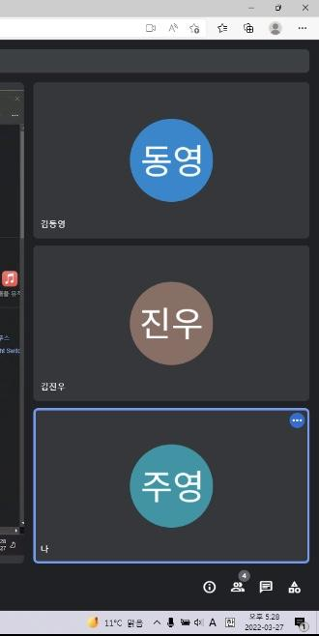
스터디원 소개 및 만남 인증
이곳에 만나서 찍은 사진을 넣어주세요.
(비대면일 경우엔 화면 캡쳐 이용)
얼굴이 나오게 찍어주셔야 합니다:D
스터디원 1 : 김동영
스터디원 2 : 김진우
스터디원 3 : 이주영

Slide 3
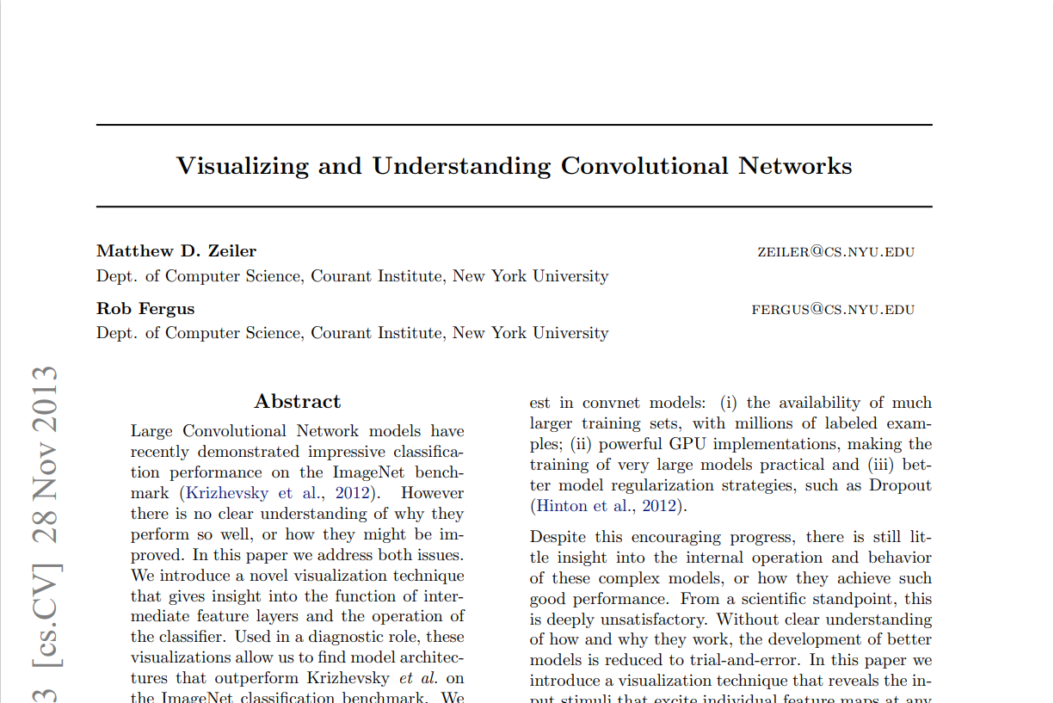
이번 논문

Slide 4
Abstract
no clear understanding of why they perform so well
& how they might be improved
insight into the function of intermediate feature layers
& the operation of the classifier

Slide 5
Introduction
Convolutional Networks (convnets)
(i) availability of much larger training sets
(ii) powerful GPU implementations
(practical training very large models)
(iii) better model regularization strategies(Dropout)

Slide 6
internal operation & how they achieve such good performance -> trial-and-error
visualization technique that reveals the input stimuli that excite individual feature maps at any layer in the model
-> evolution of features during training
& diagnose potential problems
multi-layered Deconvolutional Network (deconvnet)
-> feature activations back to the input pixel
parts of important scene for classification

Slide 7
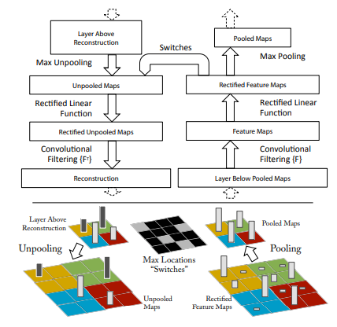
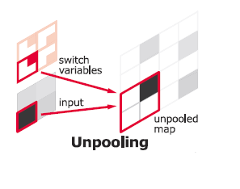
maxpooling->unpooling
activation->rectification
conv->deconv

Slide 8
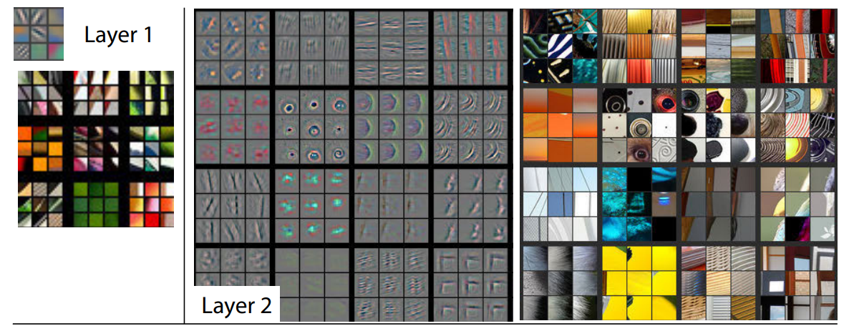
corners, edge/color

Slide 9
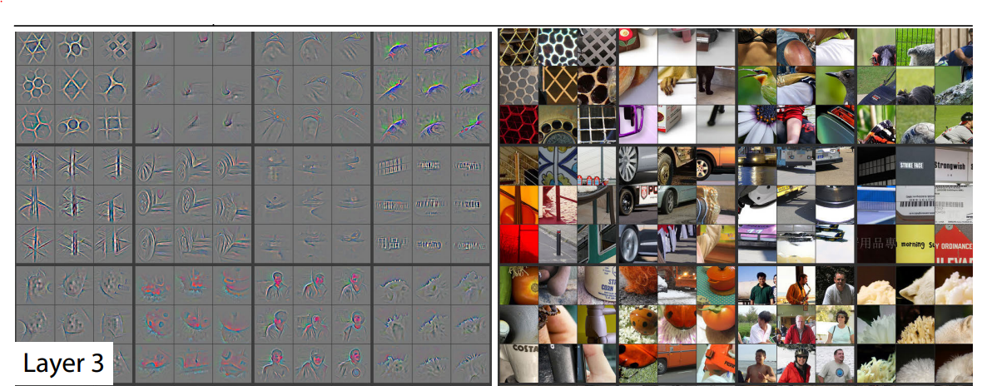
texture, mesh patterns, text

Slide 10
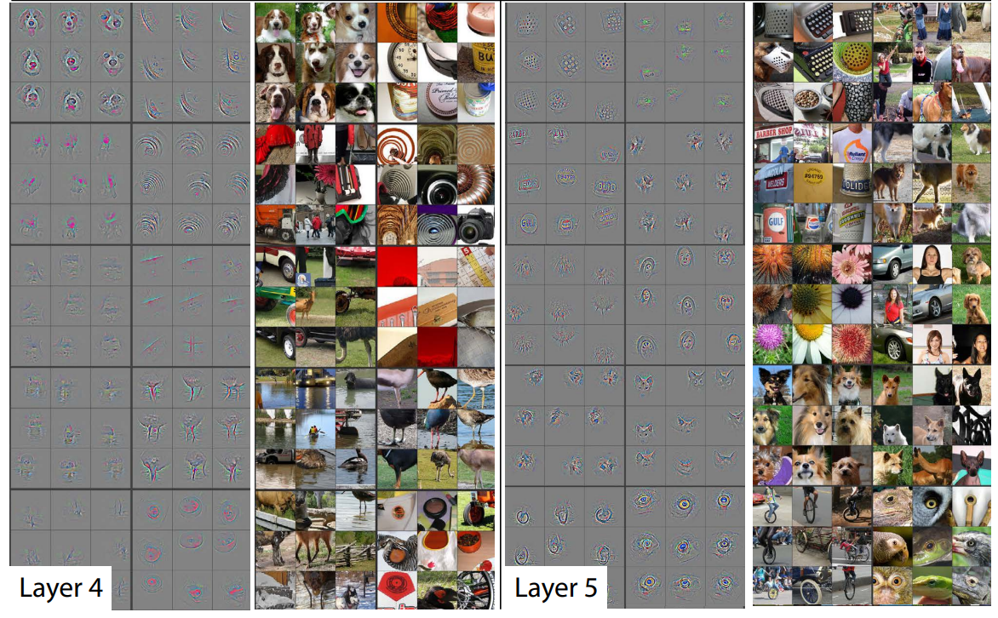
class-specific
entire objects with pose

Slide 11
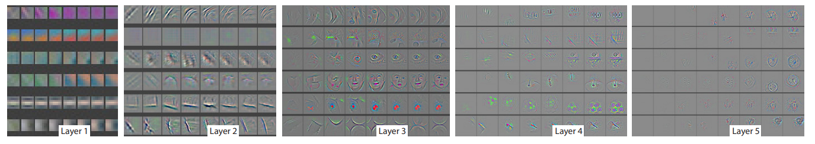
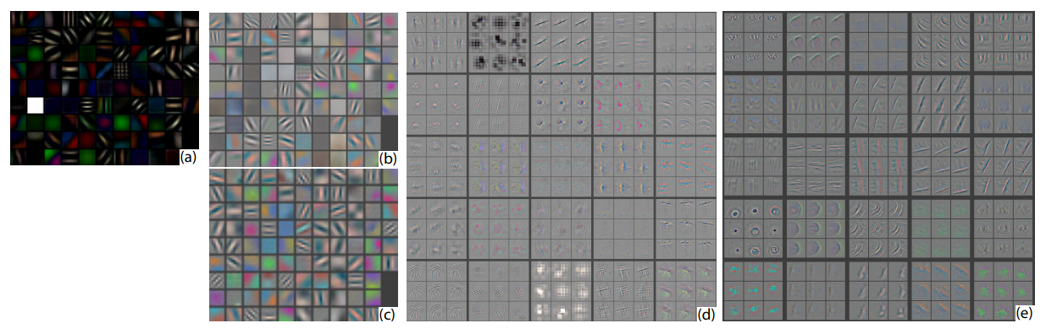
epochs [1,2,5,10,20,30,40,64]
smaller stride (2 vs 4) & filter size (7x7 vs 11x11)

Slide 12
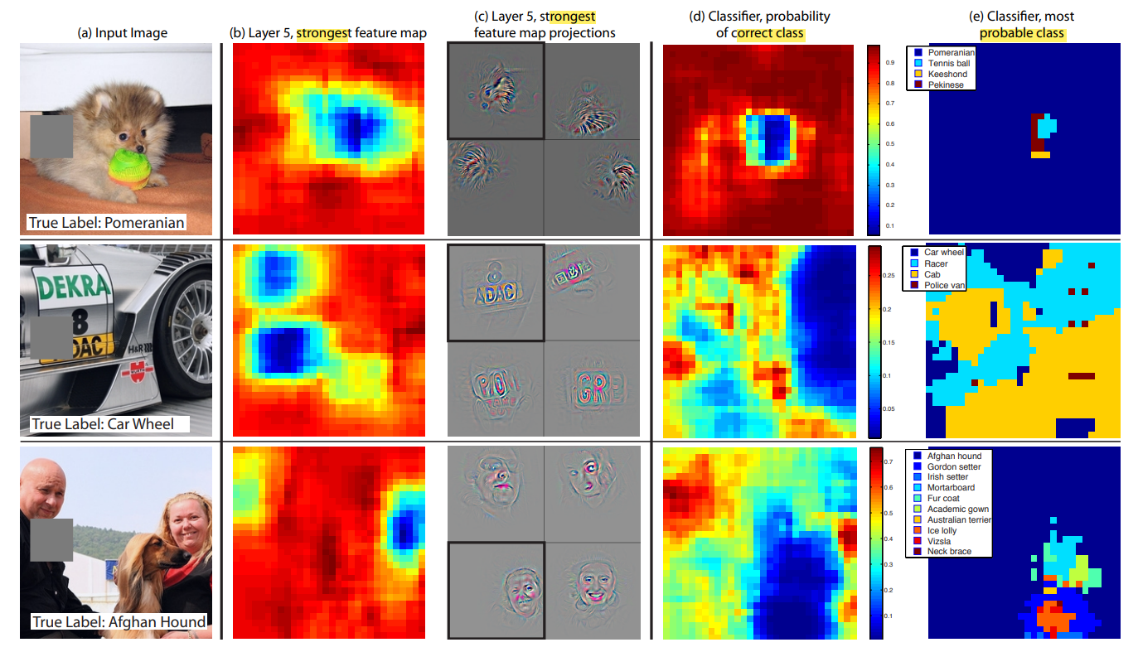

Slide 13
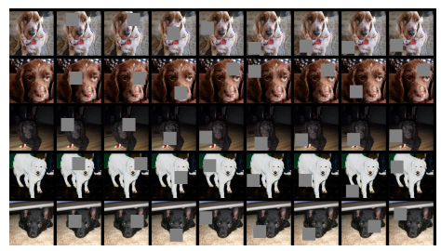
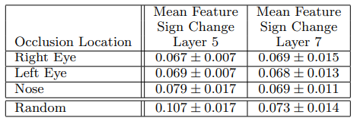
<
<
<

Slide 14
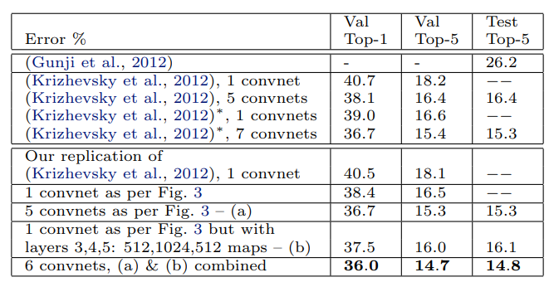
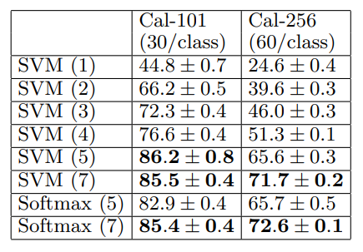
<
<

Slide 15
감사합니다

